Slide 1

What are we going to see in this session?
What is Roles in Ansible
How is Roles different from Playbook.
Organize program using Roles
File structure of Roles

Slide 2
Roles are better than playbooks
Playbooks Roles
#nginx playbook
---
- name: Install & configure nginx
hosts: web-servers
tasks:
- name: ensure nginx is at the latest version
apt: name=nginx state=latest
- name: start nginx
service:
name: nginx
state: started
#nginx-role
tasks:
- name: ensure nginx is at the latest version
apt: name=nginx state=latest
- name: start nginx
service:
name: nginx
state: started
---
- name: Install & configure nginx
hosts: web-servers
roles:
- nginx-role

Slide 3
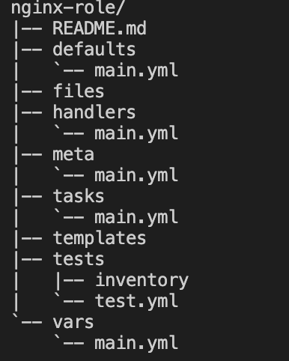
Organize Roles
Creating File structure to manage roles
ansible-galaxy init nginx-role

Slide 4
File Structure Explained
tasks
tasks:
- name: ensure nginx is at the latest version
apt: name=nginx state=latest
- name: start nginx
service:
name: nginx
state: started
vars
nginx_packages:
- nginx
nginx_config:
nginx_port: 8080
handlers
---
- name: restart nginx
service: name=nginx state=restarted
defaults
nginx_user: root
nginx_pass: root
templates
nginx_conf.j2
user {{ nginx_user }};
listen {{ nginx_port }};
meta ---
dependencies:
- { role: sslcertificates }

Slide 5
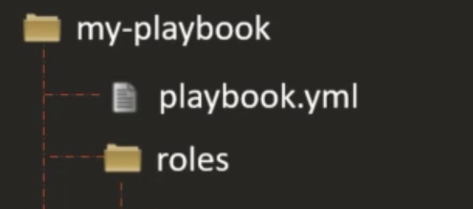
Placement of Roles
Default location for Roles can be configured at /etc/ansible/ansible.cfg
roles_path= /etc/ansible/roles
Roles can be placed in the same dir where your main playbooks are located.

Slide 6

End of this topic !
Any questions?

